Slide 1
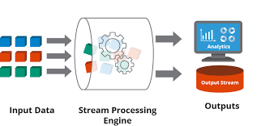
STREAM PROCESSING
Dr S Anupama Kumar
Associate Professor
Dept of AIML
RVCE

Slide 3
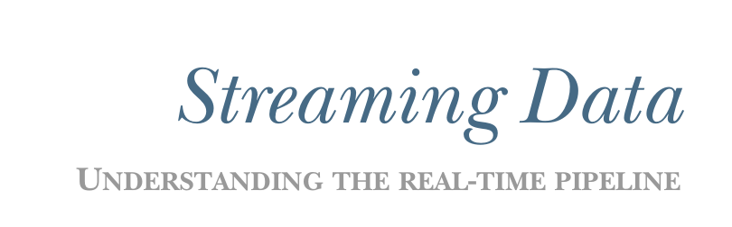
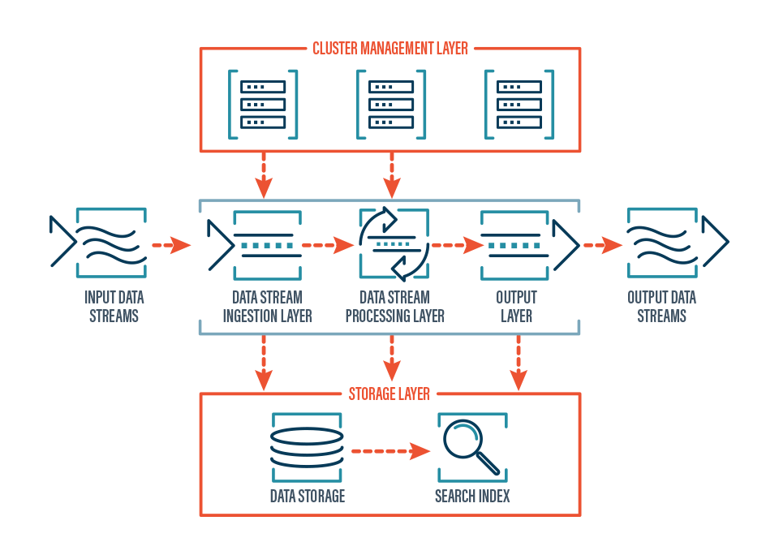


Whats in syllabus??

Slide 4
Unit -1
Introducing Streaming Data
Data Ingestion
Common Interaction patterns
Scaling the interaction patterns
Faulty tolerance

Slide 5
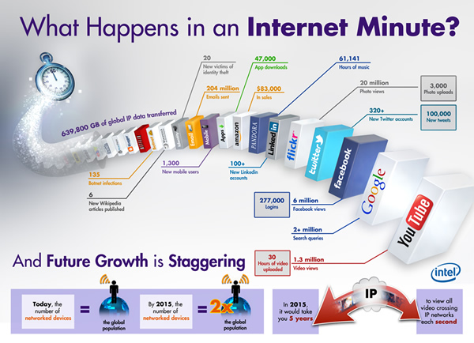
Unit -1

Slide 6
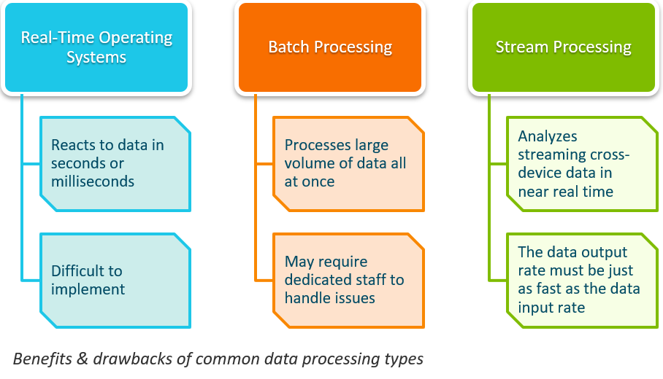
Unit -1

Slide 7
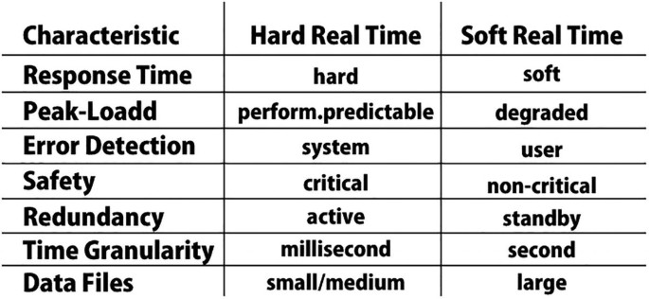
Introduction
Real Time Data
Real-time data is data that’s collected, processed, and analyzed on a continual basis.
  It’s information that’s available for use immediately after being generated.
  The data is categorized as hard , soft and Near

Slide 8
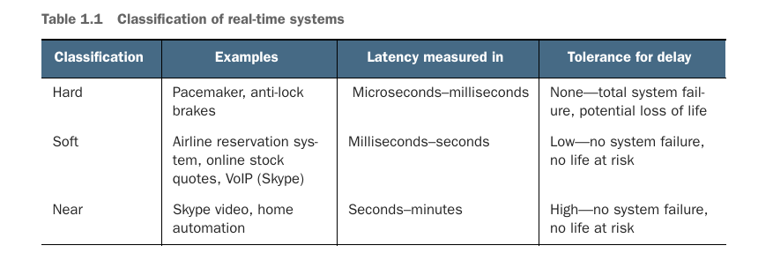
Introduction
Real Time Data

Slide 9
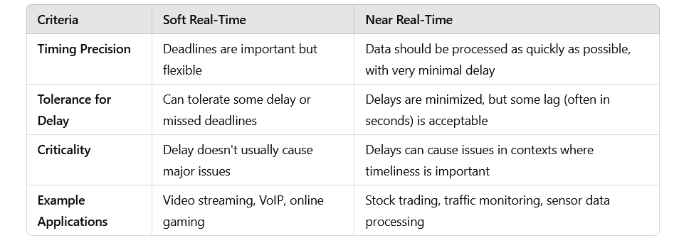
Introduction
Soft vs Near real time

Slide 10
Introduction
Soft vs NEAR Real time – Use Cases
?? because the overlap in their definitions often results in confusion
  Someone you are following on Twitter posts a tweet, and moments later you see the tweet in your Twitter client.
  You are tracking flights around New York using the real-time Live Flight Track ing service from FlightAware
  You are using the NASDAQ Real Time Quotes application to track your favorite stocks.
In each of the examples, is it reasonable to conclude that the time delay may only last for seconds, no life is at risk, and an occasional delay for minutes would not cause total system failure?

Slide 11
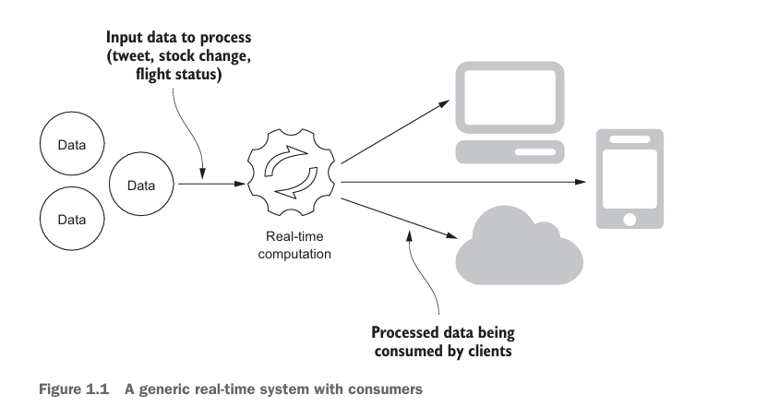
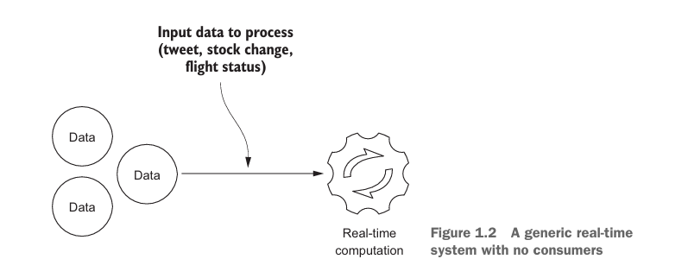
Introduction
Soft vs Non Real time
Notes:
the line differentiating soft and near real-time becomes blurry, at times disappears, is very subjective, and may often depend on the consumer of the data.

Slide 12
Introduction
Soft vs Non Real time – Use Cases
In a soft real-time system, delays are tolerable to some extent, while timely responses are preferred, occasional delays won't cause significant issues.
Examples include video streaming services where slight buffering might be acceptable.
Near real-time systems aim to minimize delays as much as possible, striving for responses that are almost instantaneous.
These systems are crucial in scenarios where even minor delays can impact performance or user experience, such as in financial trading platforms or certain medical applications.
The key difference lies in the criticality of the timing requirements and the impact of delays on the overall system performance and user satisfaction.
Notes:
the line differentiating soft and near real-time becomes blurry, at times disappears, is very subjective, and may often depend on the consumer of the data.

Slide 13
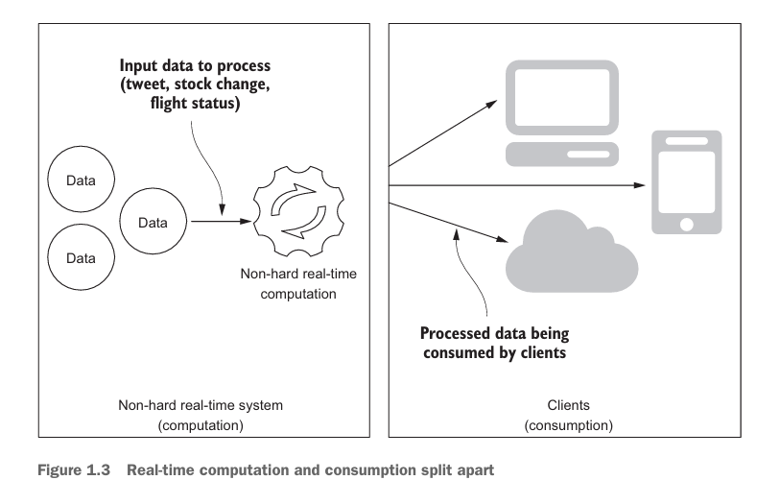
Introduction
Soft vs Non Real time
Notes:
the line differentiating soft and near real-time becomes blurry, at times disappears, is very subjective, and may often depend on the consumer of the data.

Slide 14
Streaming Data System
Streaming Data System
the computation part of the system is operating in a non-hard real-time fashion, but the clients may not be consuming the data in real time due to network delays, application design, or a client application that isn’t even running.
what we have is a non-hard real-time service with clients that consume data when they need it.
This is called a streaming data system—a non-hard real-time system that makes its data available at the moment a client application needs it.
It’s neither soft nor near—it is streaming.
Data streaming refers to the continuous transfer of data at a high velocity, enabling real-time processing and insights.

Slide 15
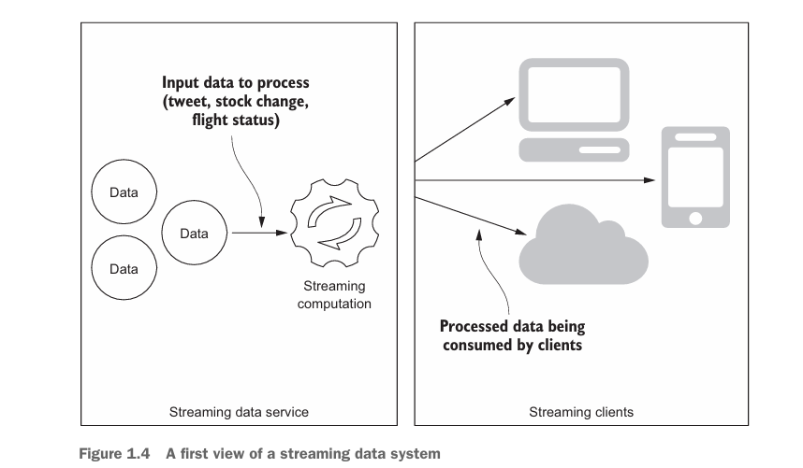
Streaming Data System

Slide 16
Streaming Data System
Redoing the Use Case :
Twitter—A streaming system that processes tweets and allows clients to request the latest tweets at the moment they are needed; some may be seconds old, and others may be hours old.
FlightAware—A streaming system that processes the most recent flight status data and allows a client to request the latest data for particular airports or flights.
NASDAQ Real Time Quotes—A streaming system that processes the price quotes of all stocks and allows clients to request the latest quote for particular stocks.

Slide 17
Streaming Data System
Need for Streaming Data :
Some data naturally comes as a never-ending stream of events.
Batch processing lets the data build up and try to process them at once while stream processing process data as they come in hence spread the processing over time
Data is huge and it is not even possible to store it.
There are a lot of streaming data available ( e.g. customer transactions, activities, website visits) and they will grow faster with IoT use cases ( all kind of sensors).

Slide 18
Streaming Data System
Features / characteristics of Streaming Data :
Chronological Significance – Need to maintain the order of flow of data
Continuous Flow
Uniqueness
Non homogeneity
Imperfection

Slide 19
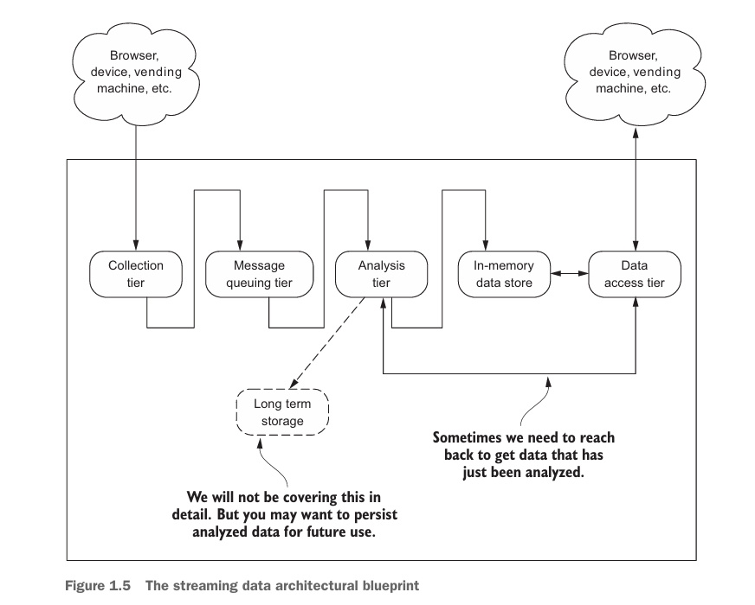
Streaming Data Architecture

Slide 20
Streaming Data Architecture
Use Case 1 : Twitter
Collection tier—When a user posts a tweet, it is collected by the Twitter services.
Message queuing tier —Twitter runs data centers in locations across the globe, and conceivably the collection of a tweet doesn’t happen in the same location as the analysis of the tweet.
Analysis tier— Twitter needs to identify the followers of a tweet.
Long-term storage tier—that tweets going back in time imply that they’re stored in a persistent data store.
In-memory data store tier—The tweets that are mere seconds old are most likely held in an in-memory data store.
Data access—All Twitter clients need to be connected to Twitter to access the service.

Slide 21
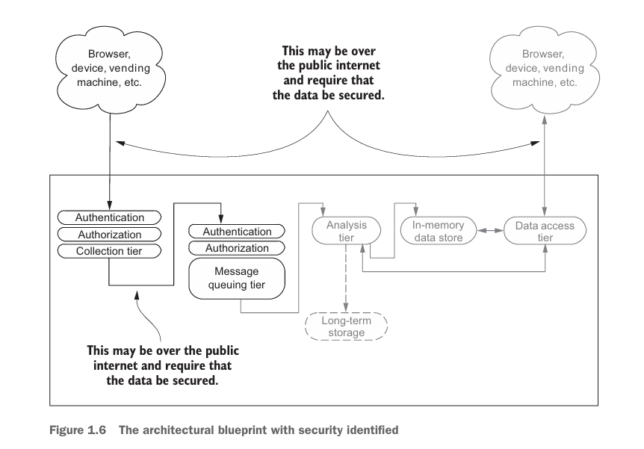
Security for streaming systems

Slide 22
Security for streaming systems
Vertical scaling lets you increase the capacity of your existing hardware (physical or virtual) or software by adding resources. (Eg Restaurant)
Horizontal scaling approaches the problem from a different angle. Instead of continuing to add resources to a server, you add servers. (High way)

Slide 23
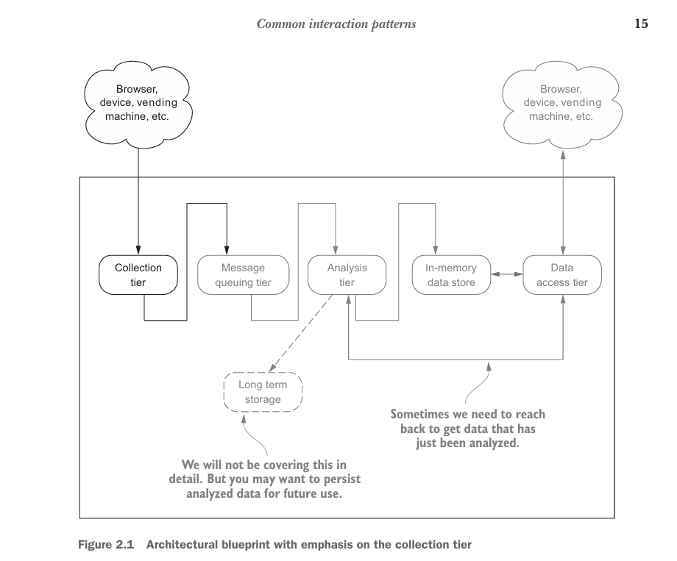
Data Ingestion
the collection patterns, how to scale, and how to improve the dependability of the tier via the application of fault-tolerance techniques

Slide 24
Common Interaction Patterns
This topic → The collection patterns, how to scale, and how to improve the dependability of the tier via the application of fault-tolerance techniques
The interaction patterns fall into one of the following categories:
Request/response pattern
Publish/subscribe pattern
One-way pattern
Request/acknowledge pattern
Stream pattern

Slide 25
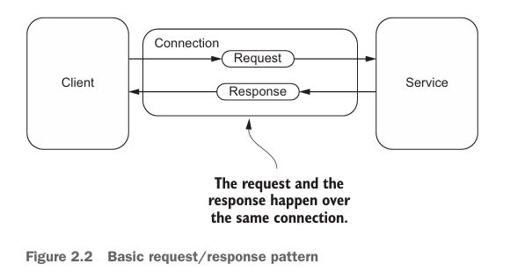
Common Interaction Patterns
(i)Request/response pattern
→ It’s used when the client must have an immediate response or wants the service to complete a task without delay.
a client makes a request to a service—this may be to take an action (such as send a text message, apply for a job, or buy an airline ticket) or to request data (such as perform a search on Google or find the current weather in their city).
the service sends a response to the client.

Slide 26
Common Interaction Patterns
Request/response pattern
The simplicity of a synchronous request and response pattern comes at the cost of the client having to wait for the response and the service having to respond in a timely fashion.
With modern-day services, this cost often results in an unacceptable experience for users.
Outside of basic services such as requesting the current weather, the potential delay is no longer tolerable.
In many cases this can translate into lost revenue for merchants because users don’t want to wait for the response.

Slide 27
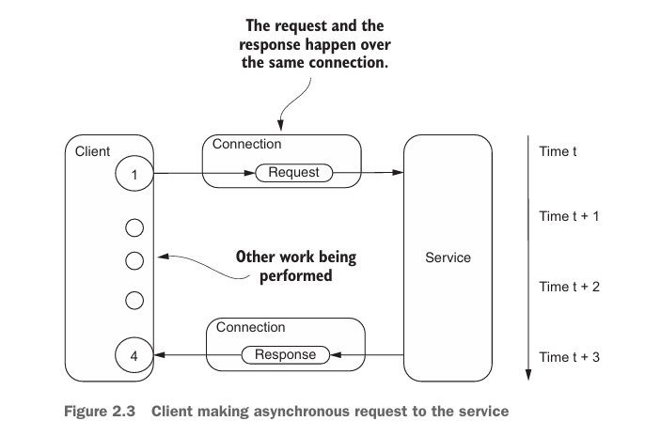
Common Interaction Patterns
Request/response pattern
Three common strategies can overcome this limitation: one on the client side, one on the service side, and one a combination of the two.
Client side - A common strategy often taken by the client is to make the requests asynchronously
This pattern is often called half-async because one half of the request response is done asynchronously.

Slide 28
Common Interaction Patterns
Request/response pattern
With the service-side half-async pattern, the service receives a request from a client, delegates the work to be done, and when the work is finished responds to the client.
This type of processing results in the development of more scalable services, which can handle requests from many more clients.
Also very common in all server side development frameworks found today for all popular programming languages.
Use cases : HTTP requests, REST APIs, RPC calls

Slide 29
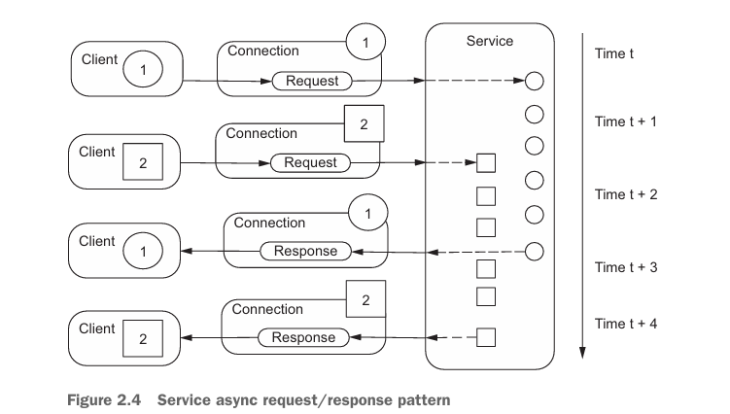
Common Interaction Patterns
Request/response pattern
Full-async, occurs when both client and server perform their work asynchronously

Slide 30
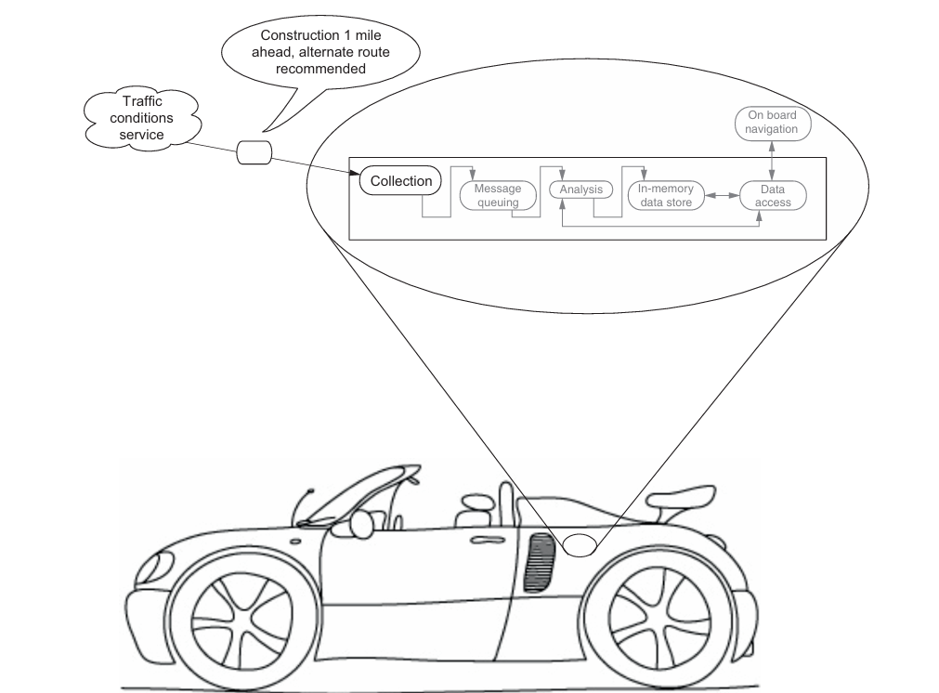
Common Interaction Patterns
Request/response pattern
Full-async- streaming system - to provide a real-time traffic and routing service for all vehicles on the road

Slide 31
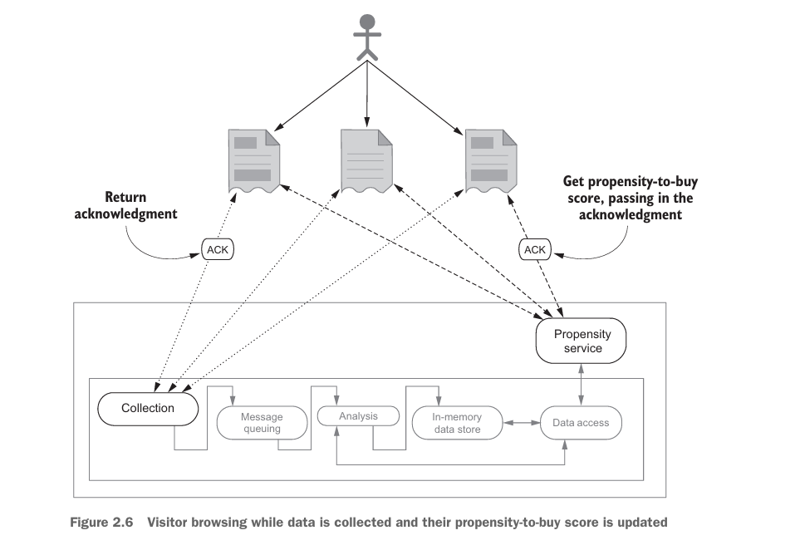
Common Interaction Patterns
(ii) Request/acknowledge
→ the data sent back in the acknowledgment can be used to make subsequent requests, perhaps to check the status of the initial request or get a final response

Slide 32
Common Interaction Patterns
(ii)Request/acknowledge
with the request/acknowledge pattern, a client makes a request of a service, asking for an action to be taken, and in turn receives an acknowledgment token that can be used in future requests.
with the request/acknowledge pattern, a client makes a request of a service, asking for an action to be taken, and in turn receives an acknowledgment token that can be used in future requests.

Slide 33
Common Interaction Patterns
Request/acknowledge
The unique thing we’re doing that’s particular to the request/acknowledge pattern occurs on the first page they visit.
On this page our collection tier returns an acknowledgment that can be used in future requests.
The request/acknowledge pattern returns data that can be used in future requests.
In this case the acknowledgment is nothing more than a unique identifier, but it plays an important role.
The acknowledgment can be used on all subsequent pages the visitor visits.
When we call the propensity service, we can pass the unique identifier we obtained on the very first visit.
With the unique identifier, which identifies the visitor, our propensity service can determine and return the visitor’s current propensity-to-purchase score.

Slide 34
Common Interaction Patterns
(iii) Publish/subscribe pattern - starts with a producer publishing a message to a broker
The Pub/Sub (Publisher/Subscriber) model is a messaging pattern used in software architecture to facilitate asynchronous communication between different components or systems.
In this model, publishers produce messages that are then consumed by subscribers

Slide 35
Common Interaction Patterns
Publisher
  The Publisher is responsible for creating and sending messages to the Pub/Sub system.
  Publishers categorize messages into topics or channels based on their content. They do not need to know the identity of the subscribers.
Subscriber
  The Subscriber is a recipient of messages in the Pub/Sub system. Subscribers express interest in receiving messages from specific topics.
  They do not need to know the identity of the publishers. Subscribers receive messages from topics to which they are subscribed.
Topic
  A Topic is a named channel or category to which messages are published. Publishers send messages to specific topics, and subscribers can subscribe to one or more topics to receive messages of interest.
  Topics help categorize messages and enable targeted message delivery to interested subscribers.

Slide 36
Common Interaction Patterns
Message Broker
  The Message Broker is an intermediary component that manages the routing of messages between publishers and subscribers.
  It receives messages from publishers and forwards them to subscribers based on their subscriptions.
  The Message Broker ensures that messages are delivered to the correct subscribers and can provide additional features such as message persistence, scalability, and reliability.
Message
  A Message is the unit of data exchanged between publishers and subscribers in the Pub/Sub system.
  Messages can contain any type of data, such as text, JSON, or binary data. Publishers create messages and send them to the Pub/Sub system, and subscribers receive and process these messages.

Slide 37
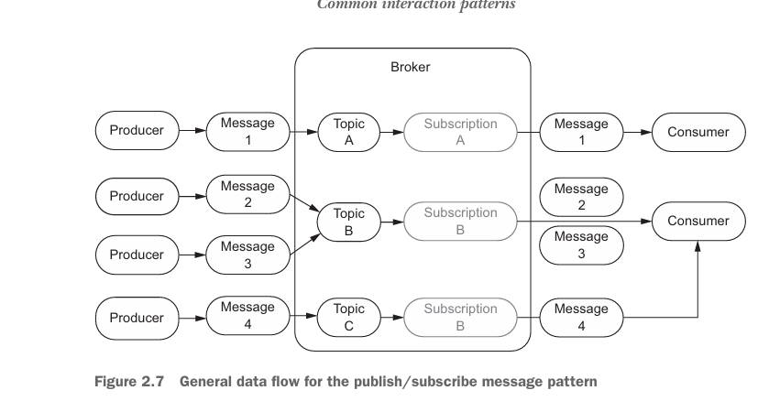
Common Interaction Patterns
Subscription
  A Subscription represents a connection between a subscriber and a topic. Subscriptions define which messages a subscriber will receive based on the topics to which it is subscribed.
  Subscriptions can have different configurations, such as message delivery guarantees (e.g., at-most-once, at-least-once) and acknowledgment mechanisms.

Slide 38
Common Interaction Patterns
Step 1: Publishers create messages and send them to the Pub/Sub system. They sort these messages into topics or channels based on what the messages are about.
Step 2: Subscribers let the system know which topics they’re interested in. They’ll get messages only from those topics.
Step 3: Topics are basically channels for messages. Publishers send their messages to specific topics, and subscribers can choose one or more topics to follow.
Step 4: Message brokers act as go-betweens, managing how messages get from publishers to subscribers. They take messages from publishers and send them to the subscribers who are interested.
Step 5: When a publisher sends a message to a topic, the message broker grabs it and sends it out to all the subscribers who have signed up for that topic.
Step 6: The Pub/Sub system allows for asynchronous communication. This means publishers can send messages without waiting for subscribers to be ready, and subscribers can pick up messages whenever it suits them, without needing the publisher to be around

Slide 39
Common Interaction Patterns
Step 1: Publishers create messages and send them to the Pub/Sub system. They sort these messages into topics or channels based on what the messages are about.
Step 2: Subscribers let the system know which topics they’re interested in. They’ll get messages only from those topics.
Step 3: Topics are basically channels for messages. Publishers send their messages to specific topics, and subscribers can choose one or more topics to follow.
Step 4: Message brokers act as go-betweens, managing how messages get from publishers to subscribers. They take messages from publishers and send them to the subscribers who are interested.
Step 5: When a publisher sends a message to a topic, the message broker grabs it and sends it out to all the subscribers who have signed up for that topic.
Step 6: The Pub/Sub system allows for asynchronous communication. This means publishers can send messages without waiting for subscribers to be ready, and subscribers can pick up messages whenever it suits them, without needing the publisher to be around

Slide 40
Common Interaction Patterns
(iv) One way Pattern
This interaction pattern is commonly found in cases where the system making the request doesn’t need a response.
It’s similar to the request/response and request/acknowledge patterns in the way a message is sent from the client to the service.
The major difference is that the service doesn’t send back a response.
In the other patterns the client knows the request was received and processed; with the one-way pattern the client doesn’t even know whether the request was received by the service.

Slide 41
Common Interaction Patterns
(iv) One way Pattern
This interaction pattern is commonly found in cases where the system making the request doesn’t need a response.
It’s similar to the request/response and request/acknowledge patterns in the way a message is sent from the client to the service.
The major difference is that the service doesn’t send back a response.
In the other patterns the client knows the request was received and processed; with the one-way pattern the client doesn’t even know whether the request was received by the service.
It’s useful in environments where a client doesn’t have the resources or the need to process a request.
Example : You’d like for the server to send data about how much memory and CPU are being used every 10 seconds. You don’t need the server to take any action or even worry about the result; it’s purely producing data as fast as possible.
it is appropriate for and often found in environments where losing some data is tolerable in exchange for simplicity, reduced resource utilization, and speed.

Slide 42
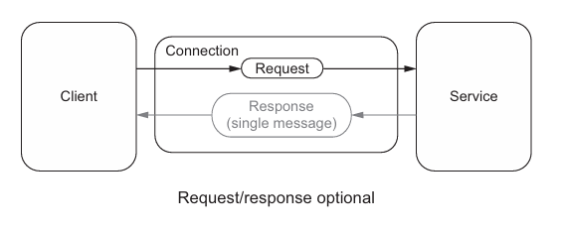
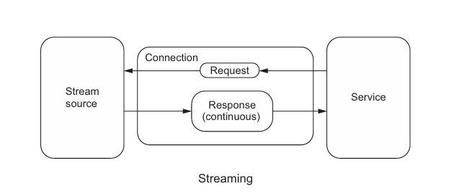
Common Interaction Patterns
(v) Stream Pattern

Slide 43
Common Interaction Patterns
(v) Stream Pattern
The data flows continuously between the system over time.
The server can send data in chunks, and the client processes these chunks as they arrive.
Key Characteristics:
Asynchronous Communication: The client or server can operate independently of the other. The client doesn’t have to wait for a response before continuing other operations.
Multiple Data Chunks: Data can be sent in continuous, partial responses (i.e., stream of data) rather than a single response.
Non-blocking Operation: The client can begin processing data as soon as it arrives, rather than waiting for the entire response.

Slide 44
Common Interaction Patterns
(v) Stream Pattern
Request-Response Pattern: Use when the communication is a one-time request, and the client can afford to wait for the server's response (e.g., API calls, web page requests).
Stream Pattern: Use when you need continuous, real-time communication or have large datasets to transmit in chunks (e.g., live updates, chat apps, video streaming).

Slide 45
Common Interaction Patterns
(v) Stream Pattern
This pattern is very interesting and powerful: ingesting a stream of data and producing another stream.
With this you can quickly build a streaming analysis system that consumes publicly available data and in turn creates new streams of data based on your analysis.
Unlike the other patterns, where you need to create or find clients to send a request to your service, with the stream pattern you can chose to connect to and process the data from a stream source.

Slide 46
Scaling Interaction Patterns
To Remember : Two types of scaling – Vertical Vs Horizontal
Vertical Scaling
Vertical scaling refers to increasing the resources (CPU, RAM, storage, etc.) of a single server or machine to make it more powerful.
This could involve upgrading an existing server or instance by adding more processing power, memory, or storage to handle more load.
Horizontal Scaling
Horizontal scaling refers to adding more machines (or nodes) to your infrastructure to distribute the load across multiple servers or instances.
Instead of upgrading a single machine, you scale out by increasing the number of machines or servers that handle requests in parallel.

Slide 47
Scaling Interaction Patterns
To Remember : Two types of scaling – Vertical Vs Horizontal
Vertical Scaling
Vertical scaling refers to increasing the resources (CPU, RAM, storage, etc.) of a single server or machine to make it more powerful.
This could involve upgrading an existing server or instance by adding more processing power, memory, or storage to handle more load.
Horizontal Scaling
Horizontal scaling refers to adding more machines (or nodes) to your infrastructure to distribute the load across multiple servers or instances.
Instead of upgrading a single machine, you scale out by increasing the number of machines or servers that handle requests in parallel.

Slide 48
Scaling Interaction Patterns
Horizontal Scaling – Request – Response Optional Pattern
Two Reasons:
with this pattern we don’t have any state information about the client making the request, which means that a client can connect and send a request to any service instance we have running.
Second—and this is a result of the stateless nature of this pattern—we can easily add new instances of this service without changing anything about the cur rently running instances.
The mode of scaling stateless services is so popular that many cloud-hosting providers, such as Amazon, offer a feature called auto-scaling that will auto matically increase or decrease the number of instances running, based on demand.
-

Slide 49
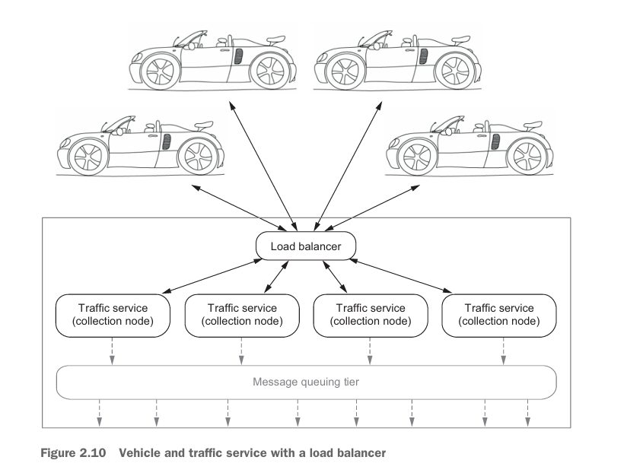
Scaling Interaction Patterns
Horizontal Scaling – Request – Response Optional Pattern
-

Slide 50
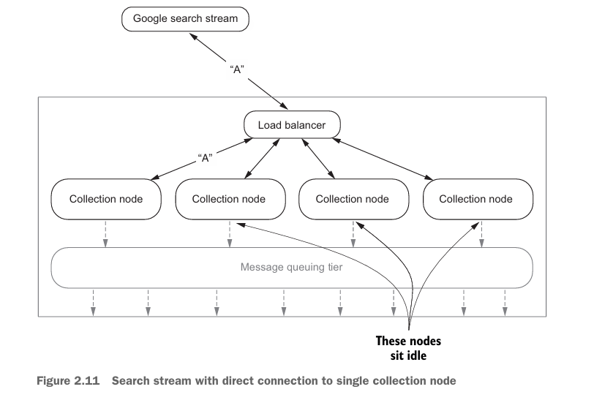
Scaling Interaction Patterns
Horizontal Scaling – Stream Pattern
horizontal scaling is our goal when building each tier of our streaming system.
-

Slide 51
Scaling Interaction Patterns
Horizontal Scaling – Stream Pattern
three of the four nodes are idle because there’s a direct connection between the search stream and the node handling the stream.
To scale our collection tier, we have a couple of options: scale up the collection node that’s consuming the stream, and introduce a buffering layer in the collection tier.
These are not mutually exclusive, and depending on the volume and velocity of the stream, both may be required.
Scaling up the node consuming the stream will get us only so far; at a certain point we’ll reach the limits of the hardware our collection node is running on and won’t be able to scale it up any further.
-

Slide 52
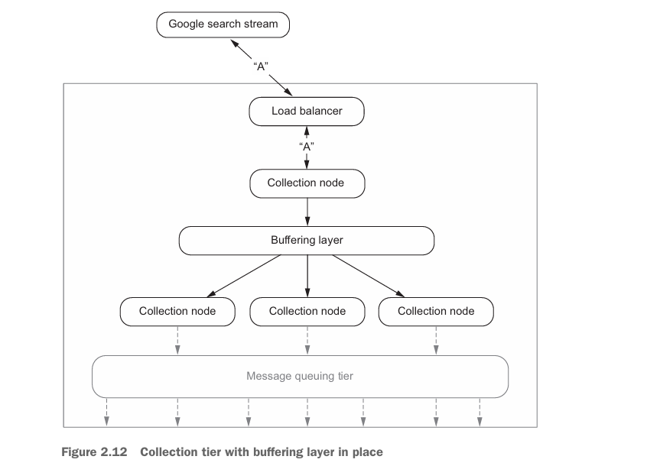
Scaling Interaction Patterns
Horizontal Scaling – Stream Pattern
-

Slide 53
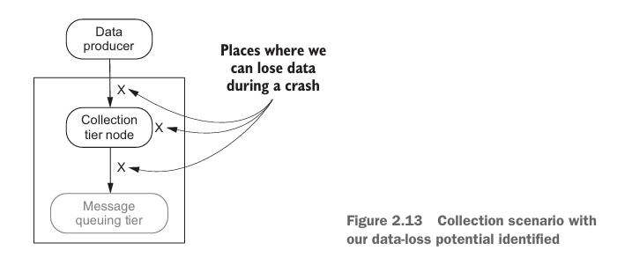
Fault Tolerance
At some point one or more of our collection nodes will fail
The failure may be the result of a bug in our software, third-party software we rely on, or the hardware our service runs on
Two Goals
          To mask the failures and to improve the dependability of our collection tier.
  When a collection node crashes (and it will), we don’t lose data and can recover as if the crash had never occurred.
  Two Approaches – Checkpointing and logging
-

Slide 54
Fault Tolerance
Check Pointing - Characteristics of Checkpointing
Global snapshot—The protocols require that a snapshot of the global state of the whole system be regularly saved to storage
Potential for data loss—The protocols only ensure that the system is recoverable up to the most recent recorded global state; any messages that were processed and generated afterward are lost.
-

Slide 55
Fault Tolerance
Global snapshot
This state is then used during recovery to put the system back into the last known state.
The potential for data loss exists if we can’t capture the global state every time data is changed in the system.
Example : autosave in popular document-editing software such as Microsoft Word or Google Docs
When considering using a checkpoint protocol for implementing fault tolerance in a streaming system, keep two things in mind:
the implications of the previously mentioned attributes
the fact that a streaming system is composed of many layers and many different technologies.
-
Notes:
A snapshot is taken of the document as you are editing it, and if the application crashes, you can recover to the last check point. If you’re like many people, you’ve seen checkpointing and potential data loss in action when your word processing program crashed and your most recent edits were not saved.

Slide 56
Fault Tolerance
Logging Protocols
Goals
overcoming the expense and complexity of checkpointing
Providing the ability to recover up to the last message received before a crash
#if a message can be replayed, then the system can reach a global consistent state without the need for a global snapshot.
Each tier in the system independently records all messages it receives and plays them back after a crash.
Implementing a logging protocol frees us from worrying about maintaining global state, enabling us to focus on how to add fault tolerance to the collection tier.
Notes:
A snapshot is taken of the document as you are editing it, and if the application crashes, you can recover to the last check point. If you’re like many people, you’ve seen checkpointing and potential data loss in action when your word processing program crashed and your most recent edits were not saved.

Slide 57
Fault Tolerance
Logging Protocols
Goals
overcoming the expense and complexity of checkpointing
Providing the ability to recover up to the last message received before a crash
#if a message can be replayed, then the system can reach a global consistent state without the need for a global snapshot.
Each tier in the system independently records all messages it receives and plays them back after a crash.
Implementing a logging protocol frees us from worrying about maintaining global state, enabling us to focus on how to add fault tolerance to the collection tier.
2 Techniques - receiver-based message logging (RBML) and sender-based message logging (SBML)
Emerging technique called hybrid message logging (HML).
Notes:
A snapshot is taken of the document as you are editing it, and if the application crashes, you can recover to the last check point. If you’re like many people, you’ve seen checkpointing and potential data loss in action when your word processing program crashed and your most recent edits were not saved.

Slide 58
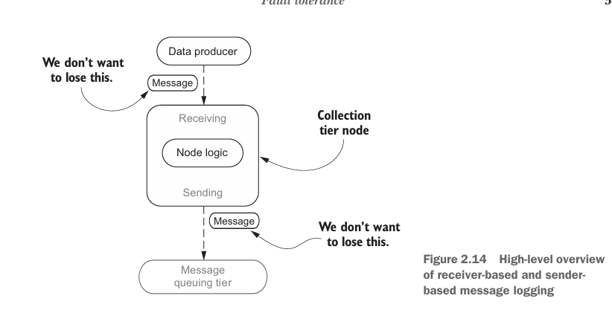
Fault Tolerance
Logging Protocols
Notes:
A snapshot is taken of the document as you are editing it, and if the application crashes, you can recover to the last check point. If you’re like many people, you’ve seen checkpointing and potential data loss in action when your word processing program crashed and your most recent edits were not saved.

Slide 59
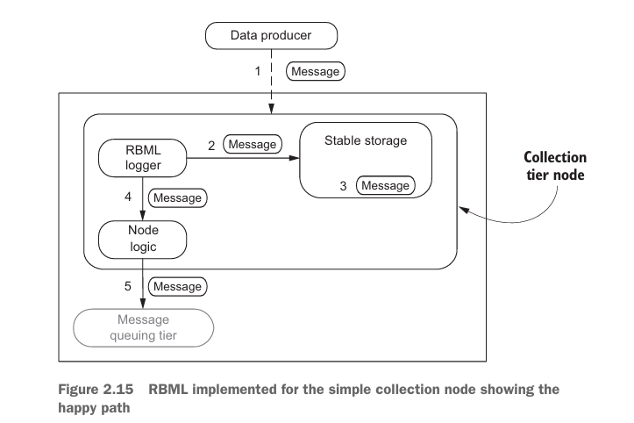
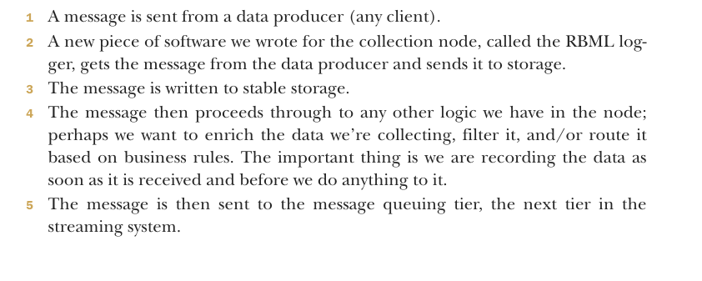
Fault Tolerance
Receiver-based message logging
Depending on the type of stable storage used, steps 2 and 3 may negatively impact the throughput performance of our collection node, sometimes noted as one of the drawbacks to logging protocols
Notes:
A snapshot is taken of the document as you are editing it, and if the application crashes, you can recover to the last check point. If you’re like many people, you’ve seen checkpointing and potential data loss in action when your word processing program crashed and your most recent edits were not saved.

Slide 60
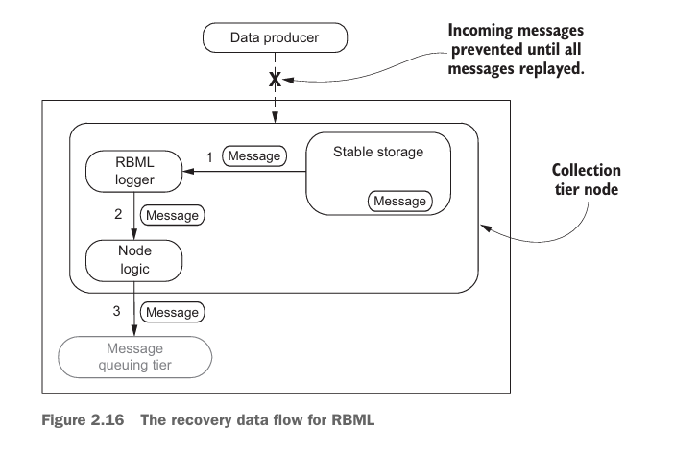
Fault Tolerance
Receiver-based message logging
Once the crash occurs, all incoming messages to this collection node are stopped.
Since we have more than one collection node and they’ll be behind a load balancer, we would take this node out of rotation.
Next, the RBML logger reads the messages that have not been processed from stable storage and sends them through the rest of the node logic as if nothing has happened.
Lastly, after all pending messages are processed, the node is considered restored and can be put back into rotation, and the data flow resumes
.

Slide 61
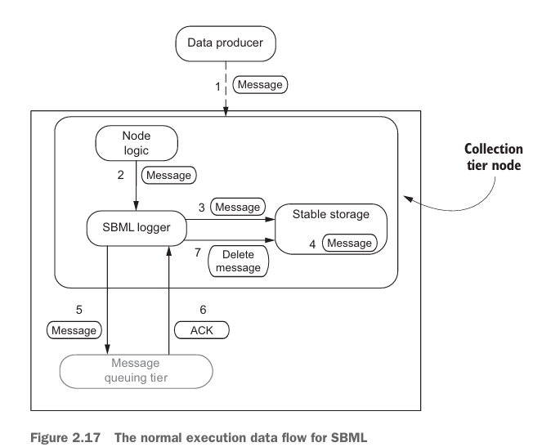
Fault Tolerance
Sender-based message logging
.
The SBML technique involves writing the message to stable storage before it is sent.
If the RBML technique logs all messages that come in the front door of our collection node to protect us from ourselves, then SBML is the act of logging all outgoing messages from our collection node before we send them, protecting ourselves from the next tier crashing or a network interruption.

Slide 62
Fault Tolerance
Sender-based message logging
RBML Vs SBML
with RBML we are recording the message as soon as it is received before we do anything to it, and with SBML we are recording it before we send any data to the next tier.
The data recorded by an RBML logger is the raw incoming data, and the data recorded by the SBML logger is after our node logic executes (remember, we may have augmented the data in some way) and before we send it on.
Recovery
.

Slide 63
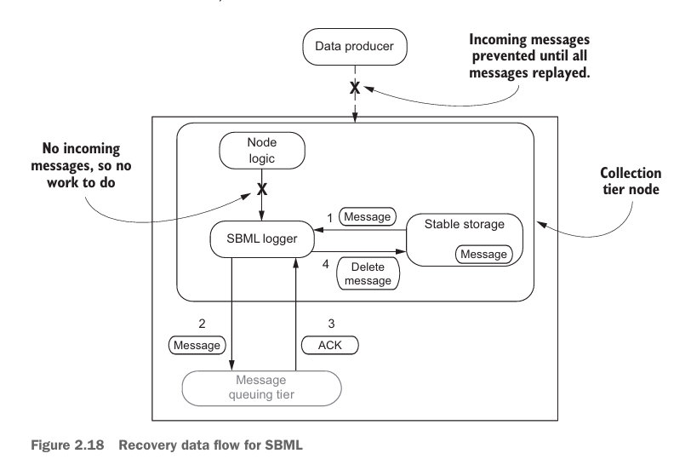
Fault Tolerance
Recovery
.

Slide 64
Fault Tolerance
Hybrid Message Logging
.

